Slide 1
Antipsychotics academic detailing
Prepared for Testing RACF
By i3soft, presented by Your Name

Slide 2
Medicines Used
• Calming and sedative medicines can be used to treat Behavioural Symptoms of Dementia.
• Example medicines include: Risperidone, Olanzapine, Quetiapine, Aripiprazole, Haloperidol, Paliperidone, Trifluoperazine and Ziprasidone
• However, these medicines are known to have serious side effects, including stroke, falls, confusion, increased pneumonia, movement disorders (e.g. tremor) and increased chance of death.
Prepared for Testing RACF by i3soft, presented by Mr Peter GEE. Created 6/12/2016

Slide 3
Key Points
• Antipsychotics are effective in approximately one in five dementia patients for short-term management of significant agitation, aggression and psychosis.
• Antipsychotics are less effective for some types of behavioural problems, for example, wandering, calling out, urinating in inappropriate places and hypersexuality
Prepared for Testing RACF by i3soft, presented by Mr Peter GEE. Created 6/12/2016

Slide 4
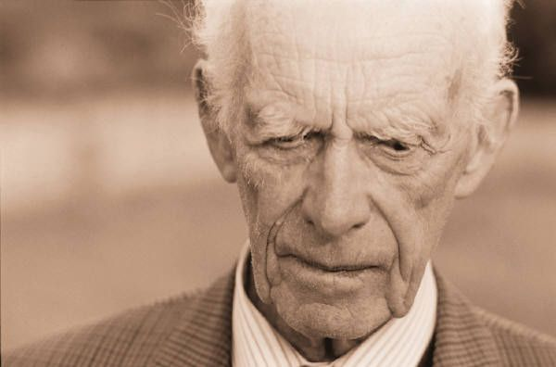
Key Points
• Non-pharmacologic therapy is equally or more effective than antipsychotics in many people with BPSD.
• Antipsychotics may precipitate adverse effects, some of which mimic behavioural and psychological symptoms of dementia.
• Serious adverse effects of antipsychotic agents include falls, increased mortality and increased risk of strokes.
Prepared for Testing RACF by i3soft, presented by Mr Peter GEE. Created 6/12/2016

Slide 5
Key Points
• Some people are more sensitive to the adverse effects of antipsychotic agents, such as those with Parkinson’s Disease, Lewy Body Dementia or cardiac damage.
• Most people on long-term antipsychotics for BPSD can have their antipsychotics ceased, often with an improvement in symptoms.
Prepared for Testing RACF by i3soft, presented by Mr Peter GEE. Created 6/12/2016

Slide 6
Strategies for reduction
• People with dementia whose behavioural symptoms are unchanged or improving over weeks or months may bene t from a trial reduction.
• People who no longer have troublesome BPSD may benefit from a trial reduction.
• People who have been symptom or behaviour-free for three months or more should be considered for a trial reduction.
• Cessation should be gradual, particularly if use has been long-term.
• The Dementia Behaviour Management Advisory Service has developed a BPSD Guide, which is available as a phone or device application.
Prepared for Testing RACF by i3soft, presented by Mr Peter GEE. Created 6/12/2016

Slide 7
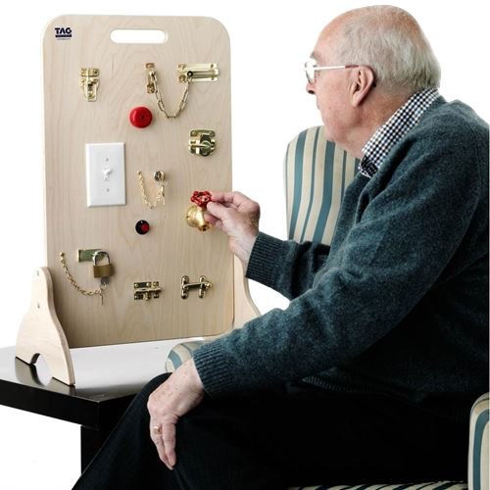
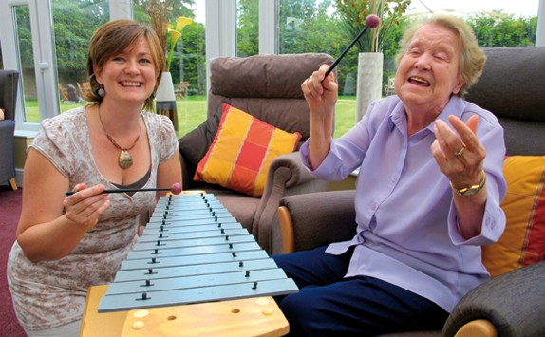
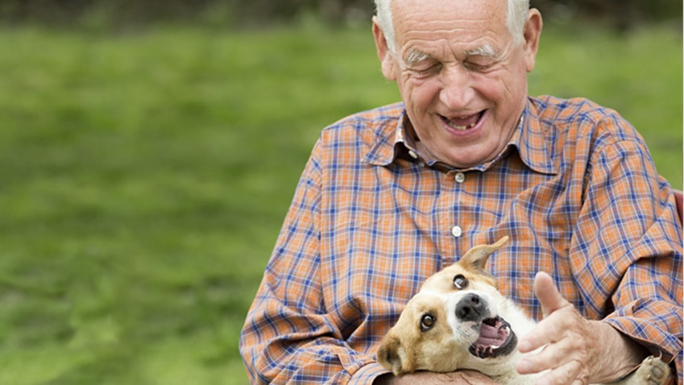
Non-drug treatments
Prepared for Testing RACF by i3soft, presented by Mr Peter GEE. Created 6/12/2016

Slide 8
Demographics
Prepared for Testing RACF by i3soft, presented by Mr Peter GEE. Created 6/12/2016

Slide 9
How do we compare?
Prepared for Testing RACF by i3soft, presented by Mr Peter GEE. Created 6/12/2016

Slide 10
Which Medicines are used?
Prepared for Testing RACF by i3soft, presented by Mr Peter GEE. Created 6/12/2016

Slide 11
Overview
This presentation has:
• Described common antipsychotic medicines
• Given an overview of problems with the medicines
• Explored some non-drug alternatives
• Presented usage statistics at your facility
Made with
Prepared for Testing RACF by i3soft, presented by Mr Peter GEE. Created 6/12/2016

